Slide 1

CSE-5335: Presentation
TEAM MEMBERS :
Soni, Parth Vijaykumar- 1002053647
Sunku, Sumeghana - 1002063330
Kamisetty, Muni Heshwant Kumar - 1002129854
Singareddy, Akshitha - 1002073447
Surneni, Sumanth Eshwar Sai - 1002087310
Section: 5335-002
FALL 2023

Slide 2

PHASE 5 Demo
Pages before Login

Slide 3


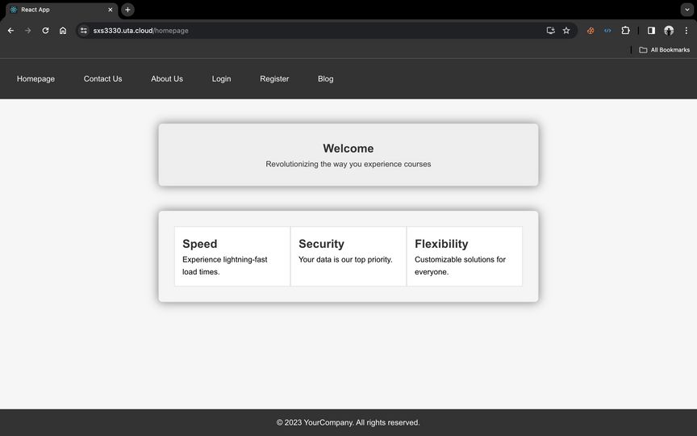
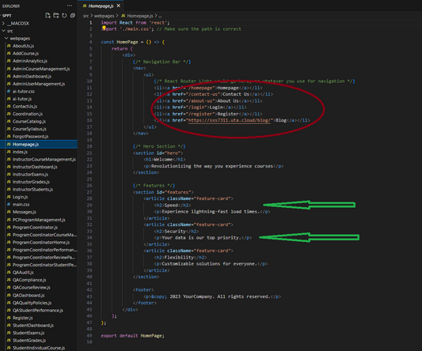
Page : HOMEPAGE
'Home', 'Contact Us', 'About Us', 'Login', 'Register', and 'Blog' are the contents in the Homepage. Homepage is designed to be user-friendly and informative, providing visitors with a snapshot of the academic program's goals and the platform's commitment to quality, efficiency, and user-centered design. The layout is responsive, ensuring a seamless experience across various devices and screen sizes, and adheres to web accessibility guidelines to serve a diverse range of users.

Slide 4
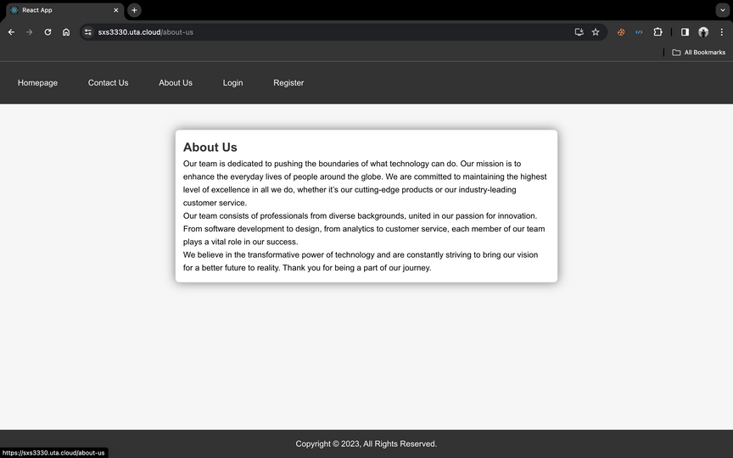
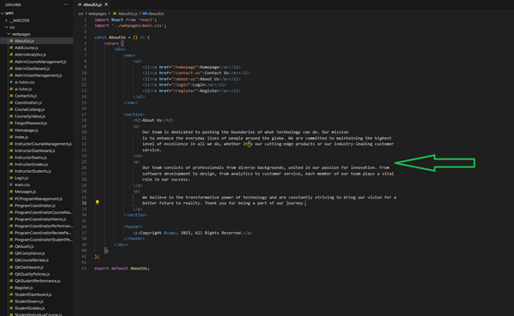
Page : ABOUTUS
The "About Us" page for our website serves as a testament to the ethos and mission of our team.

Slide 5
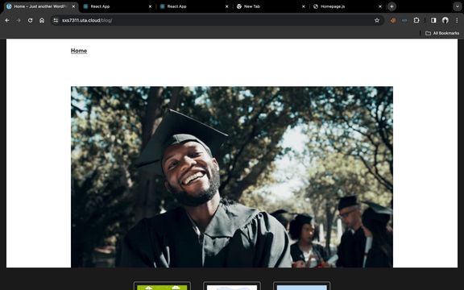
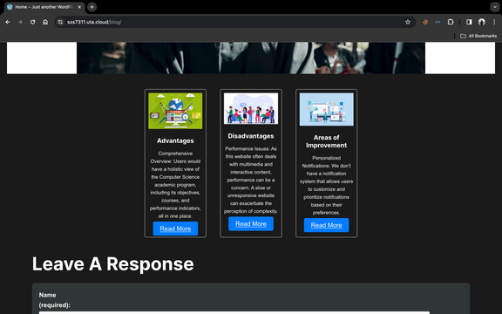
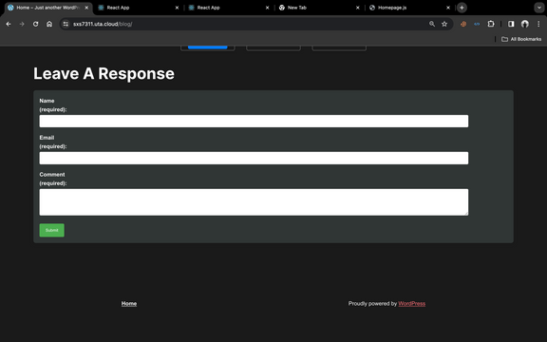
BLOG
Our blog is meticulously crafted on WordPress, the leading content management system, allowing for seamless content creation and management.
Engaging Posts: Currently, our blog features three insightful posts, each offering a deep dive into the various facets of our system:
Advantages of the System: This post highlights the unique benefits our system offers, including increased efficiency, user-friendly design, and innovative features that stand out in the market.
Disadvantages of the System: In our commitment to transparency, we also address potential drawbacks, inviting user feedback for continuous improvement.
Room for improvement
This blog served as a valuable feedback tool for ongoing development and refinement.

Slide 6
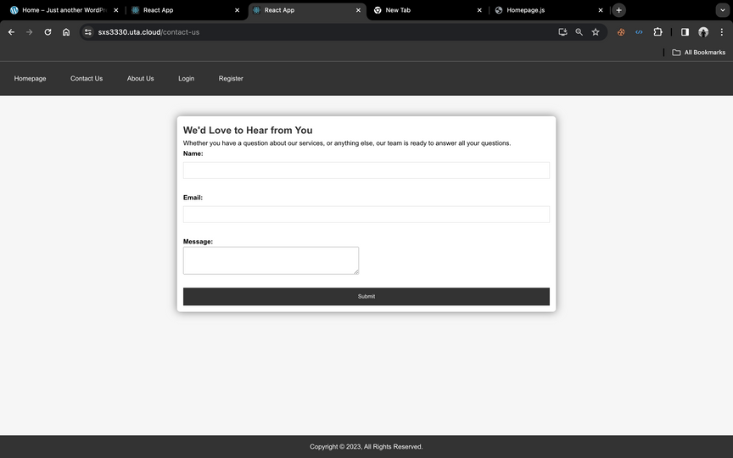
CONTACT US
We maintain the highest standards of excellence in all our interactions. Expect nothing less than the latest updates, informed advice, and courteous service from our professionals, who are united in their passion for excellence and innovation.
Contact Form includes :
Name: [Your Full Name]
Email: [Your Email Address]
Submit your inquiry, and we'll be in touch soon.
We're Here for You
Believe in the transformative power of technology, and join us in this journey to a brighter future. Your insights and interactions are invaluable to us. Thank you for reaching out and being a part of our mission.

Slide 7
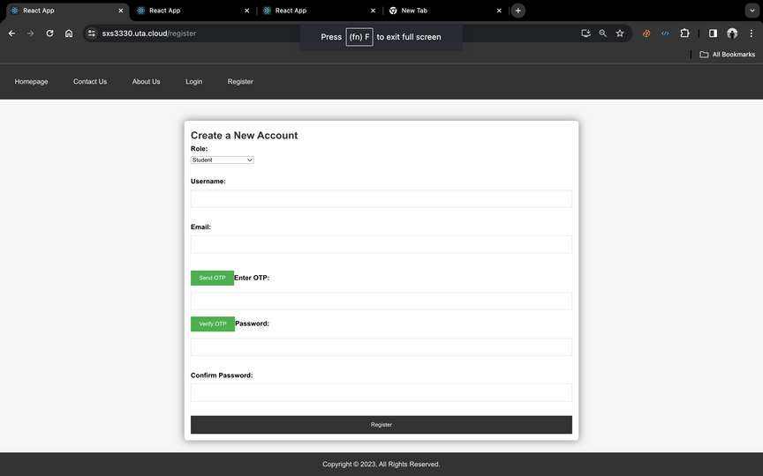
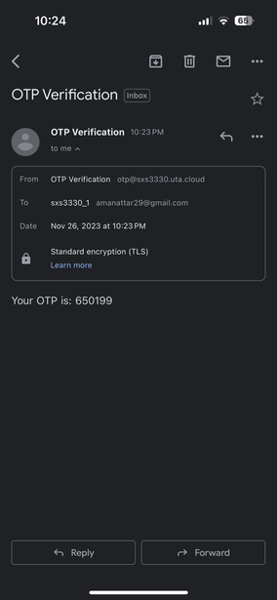
Register using OTP
Sign-Up Form: Begin your journey with us by filling out the basic sign-up form. Provide your essential details, including your name and email address.
OTP Verification: To ensure the security of your account, we will send a One-Time Password (OTP) to the email you provided. This unique code verifies that the email address belongs to you.
Enter OTP: Check your email inbox for the OTP. Enter this code into the designated field on our registration page to confirm your identity.
Account Creation: Once your email is verified through the OTP, you can proceed to set up your user profile. Create a secure password, and provide any additional information required to personalize your experience with us.
Confirmation: After your details are submitted and verified, you'll receive a confirmation that your account has been successfully created. You can now access the full suite of features and services we offer.
Security Note: The OTP is only valid for a short period, ensuring that only you can register with your email address. If the OTP expires, you can request a new one to complete your registration.

Slide 8
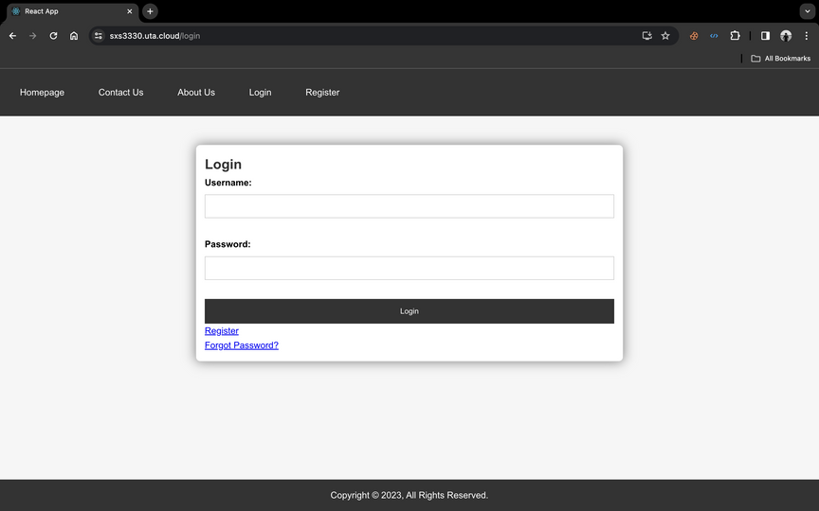
LOGIN PAGES
Our login page is designed to provide you with quick and secure access to your personalized dashboard. We value your time and privacy, which is why we've streamlined the process to be as simple as it is secure.
Simple Steps to Sign In:
Email Address: Enter the email address associated with your account. It's your unique identifier that connects you to your profile and data.
Password: Input your password, knowing that it's encrypted and stored securely to protect your personal information.
One-Click Login: With just one click on the 'Sign In' button, you'll be taken to your dashboard, where you can manage your preferences, access services, and start exploring.

Slide 9
SEMINAR Demo
Login Landing

Slide 10
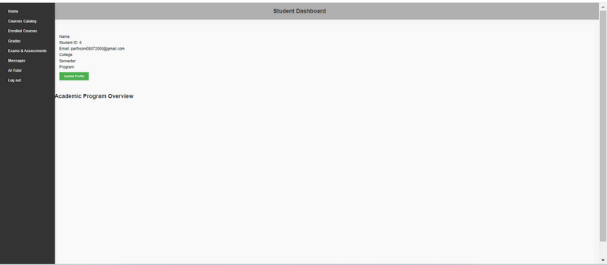
PROFILE
As a newly registered user, you've just embarked on a new journey with our platform. You've successfully navigated through our straightforward sign-up process, where you provided essential details and verified your email address, possibly through an OTP (One-Time Password) for enhanced security.
Upon registration, you now have a personal user profile that can be customized to fit your preferences. You have access to various features and services that our platform offers, and you can start exploring them right away. Whether it's accessing exclusive content, enrolling in programs, or using our specialized tools, the full breadth of our platform is now at your fingertips.

Slide 11
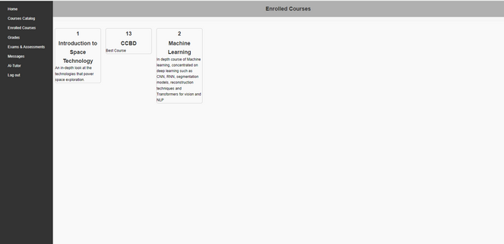
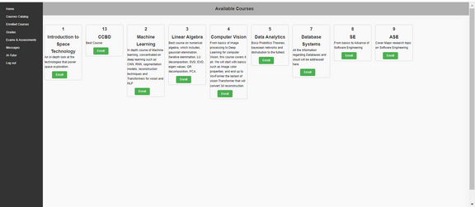
STUDENT FUNCTIONALITY
This is student enrolled cources page. When he clicks on enroll,he will be enrolled in the desired courses.On the students courses page, all the list of available courses will be displayed

Slide 12
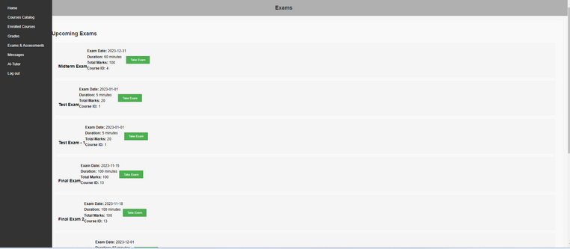
STUDENT FUNCTIONALITY
As a student on our platform, you will have a tailored view of the courses, exclusively showing the ones in which you are enrolled. This feature is designed to create a focused and clutter-free learning environment, enhancing your educational experience.

Slide 13
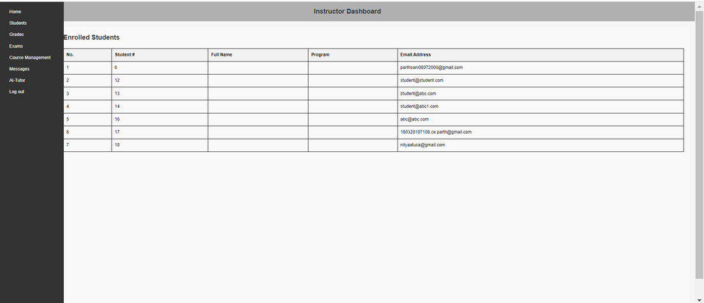
INSTRUCTOR FUNCTIONALITY
Instructor can view list of students that is enrolled in his respective course

Slide 14
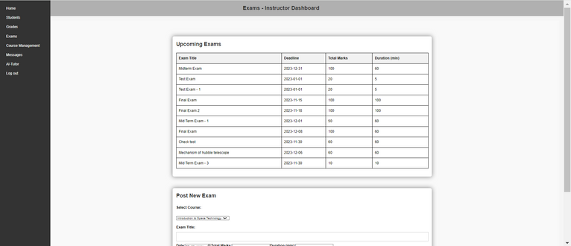
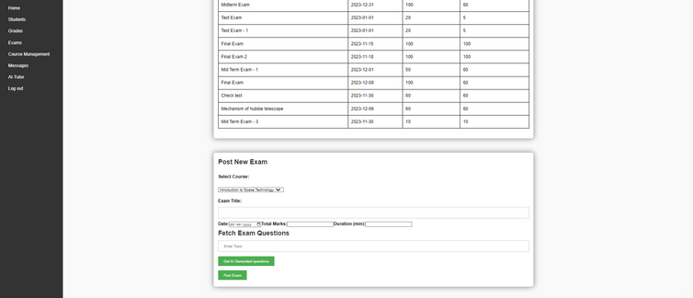
INSTRUCTOR FUNCTIONALITY
“Create and Post Exam" Functionality for Instructors
Empowering Instructors with Comprehensive Assessment Tools
Our platform provides instructors with an intuitive and robust system to create and post exams, enabling them to effectively evaluate student learning and performance.

Slide 15
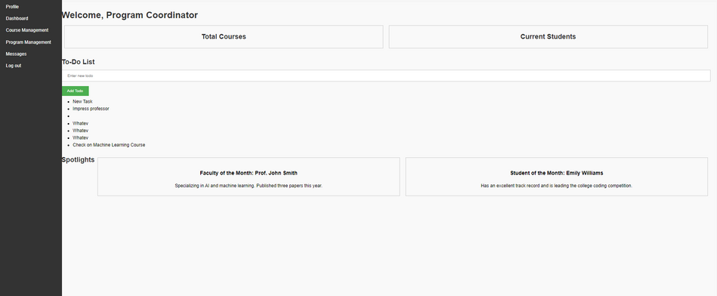
PC FUNCTIONALITY
This is the dashboard of PC.Program coordinator can add new tasks and can monitor his objectives

Slide 16
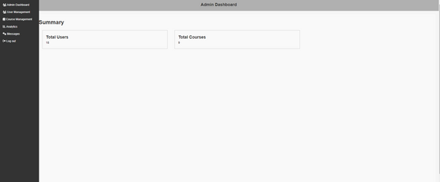
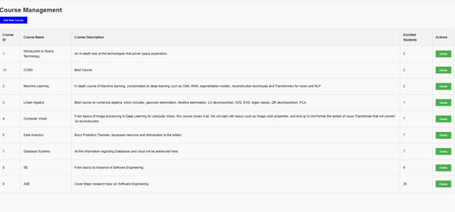
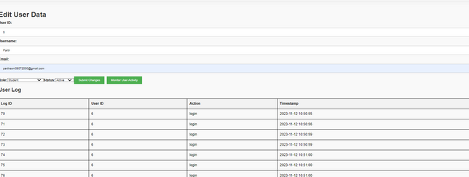
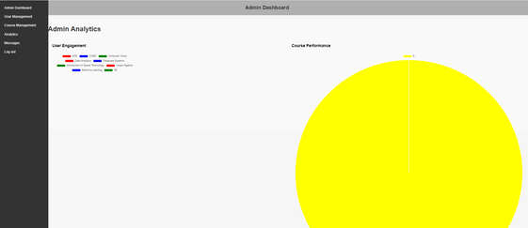
ADMIN FUNCTIONALITY
These are the functionalities of the admin.

Slide 17
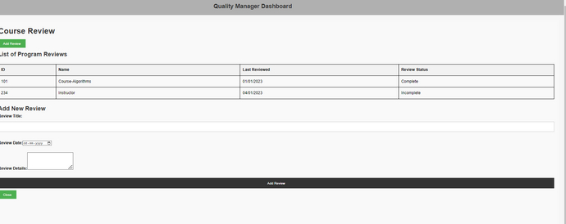
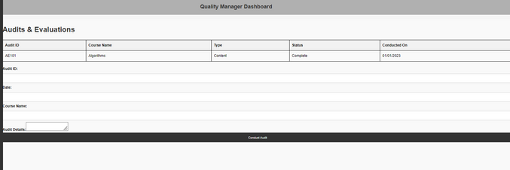
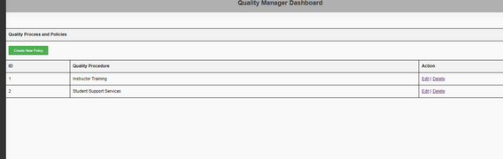
QA FUNCTIONALITY
QA can create new policies for the users
QA can conduct audits and evaluation if needed
QA can do course evaluation

Slide 18
SEMINAR Demo
Node/ Chat

Slide 19
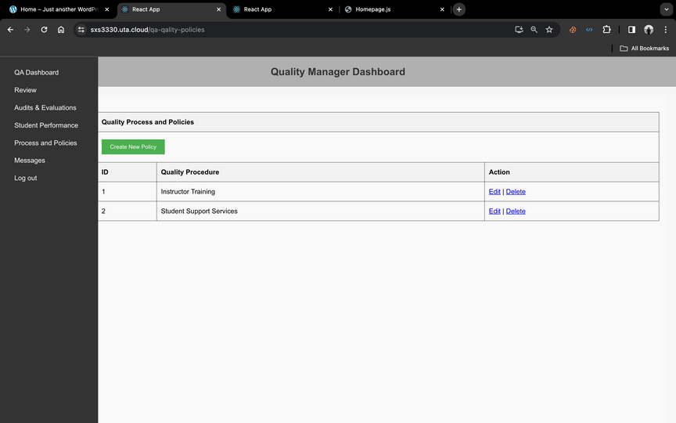
CHAT
Development and Implementation: Facilitates the creation and execution of quality assurance strategies.
Recommendations: Officers can suggest improvements in teaching methods, assessments, and program efficiency.
CRUD Functionality: Create, Read, Update, and Delete options for managing quality procedures.
Communication: Integrated chat feature for real-time collaboration and discussion.
Reporting: Dedicated page or dashboard integration to display reports on quality measures and outcomes.

Slide 20

Challenges faced
Data Security:
Resolution: Implemented robust encryption protocols and access controls. Regular security audits were conducted to identify and address vulnerabilities. User authentication mechanisms were strengthened, and data storage practices were aligned with industry standards.
Integration of Technologies:
Resolution: Adopted a modular approach and implemented the Model-View-Controller (MVC) framework. This allowed for the seamless integration of various technologies, ensuring a cohesive and scalable system. Regular compatibility checks were conducted during updates or new technology integrations.
Adapting to Evolving Educational Needs:
Resolution: Maintained close collaboration with educators and stakeholders to gather feedback. Implemented an agile development methodology to facilitate quick adjustments to changing requirements. Regularly updated the system based on educational trends and user feedback.
MVC Framework Implementation:
Resolution: Took a phased approach to implement the MVC framework, starting with a detailed analysis of the existing system. Developed a migration plan to minimize disruptions, ensuring that each module was thoroughly tested before integration. Conducted training sessions for the development team to familiarize them with the new architecture.
Seamless Integration of Chat Feature:
Resolution: Utilized a well-documented API for the chat feature, ensuring compatibility with existing modules. Conducted thorough testing to identify and resolve integration issues. Implemented user-friendly interfaces and provided training resources to users to promote effective utilization of the new communication tool.

Slide 21
SEMINAR Demo
IMPROVEMENT

Slide 22
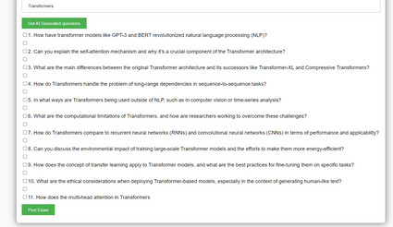
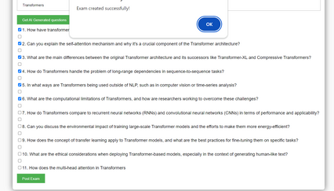
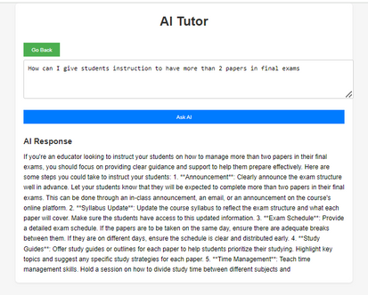
AI IMPROVEMENT
AI-Generated Examinations:
The system utilizes AI to automatically generate examination questions.
Questions are designed to probe deep understanding and cover a range of complexities.
Educator's Instructional Aid:
AI provides structured guidelines on how to instruct students effectively.
Assists in managing multiple exam schedules and study loads.
CRUD Functionality for Dynamic Learning:
Enables educators to Create, Read, Update, and Delete exam content in real-time.
Adapts to the evolving educational needs and performance of students.
Integrated Communication Tools:
Features a chat system to facilitate instant communication between students and educators.
Encourages collaborative learning and immediate resolution of queries.
Data-Driven Insights and Reporting:
Automatically generates reports on student performance.
Informs educators about the effectiveness of teaching methods and assessment tools.
Transfer Learning and Ethical Deployment:
Incorporates the concept of transfer learning to adapt models to specific tasks.
Educates on the ethical considerations in deploying AI models for generating text and assessments.

Slide 23

Future Addition to your Portfolio
1. Proactive Security Measures:
- Improvement: Regularly conduct simulated security breaches and penetration testing to identify vulnerabilities proactively.
- Justification: Anticipating potential security threats and addressing them before they are exploited enhances the overall resilience of the system, ensuring a more robust defense against emerging risks.
2. Agile Development with Continuous User Feedback:
- Improvement: Implement an even more agile development process with shorter iteration cycles and continuous user feedback loops.
- Justification: Faster development cycles and immediate user feedback enable quicker adaptation to evolving needs, ensuring that the system stays aligned with the dynamic requirements of the educational sector.
3. Comprehensive Technology Compatibility Testing:
- Improvement: Enhance technology compatibility testing by investing in a dedicated testing environment that mirrors real-world usage scenarios more accurately.
- Justification: A comprehensive testing environment facilitates the detection of potential integration issues and ensures a smoother adoption of new technologies, minimizing disruptions for end-users.
4. User Training and Support:
- Improvement: Develop a more extensive and accessible training program, including video tutorials and interactive guides.
- Justification: A well-rounded training program enhances user adoption and proficiency, reducing the learning curve and potential frustration associated with new features or system changes.
5. AI Integration Roadmap:
- Improvement: Develop a detailed AI integration roadmap that includes specific milestones and measurable success criteria.
- Justification: A clear roadmap provides a structured approach to AI integration, helping manage expectations, measure progress, and ensure that the implementation aligns with the strategic goals of the educational institution.

Slide 24

Thank You

